Slide 1
Amazon Data Analysis
Princee Chimnani

Slide 2
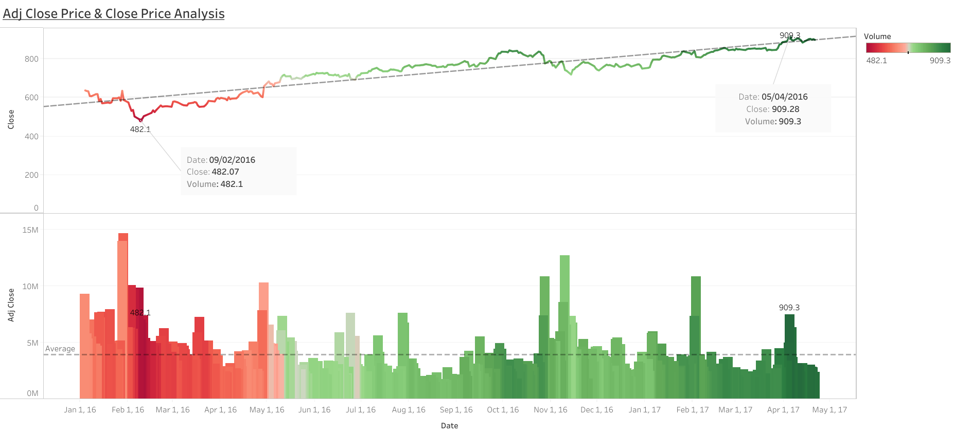

Slide 3
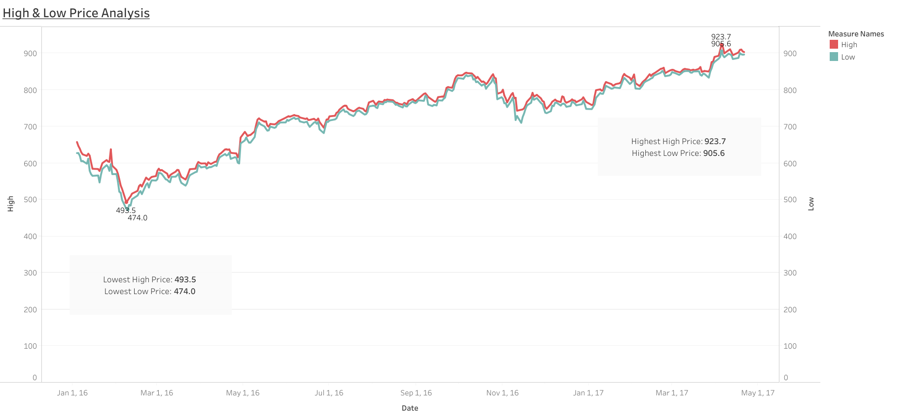

Slide 4
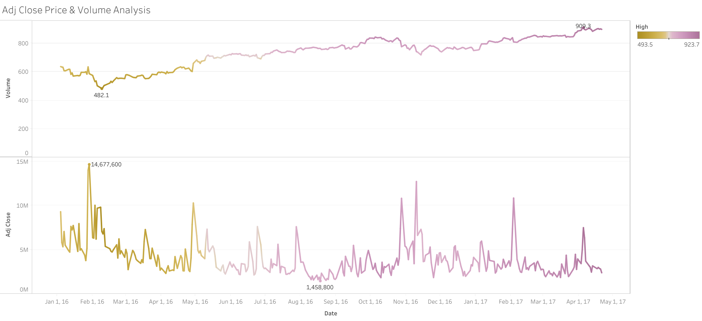

Slide 5
